Slide 1
Two-Dimensional Arrays and Nested Loops – part 1
Barb Ericson
Georgia Institute of Technology
August 2005

Slide 2
Learning Goals
Understand at a conceptual and practical level
  What is a two-dimensional array?
  How do you get the pixel for a x and y location?
  How do you use nested loops?
  How to convert a single for loop to a nested for loop?

Slide 3
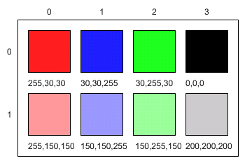
What is a two-dimensional array?
The pixels in a picture are really stored in a two-dimensional array
  Each pixel has a x value (horizontal location)
  Each pixel has a y value (vertical location)
  pictureObj.getPixel(x,y) returns the pixel at that location
x
y

Slide 4
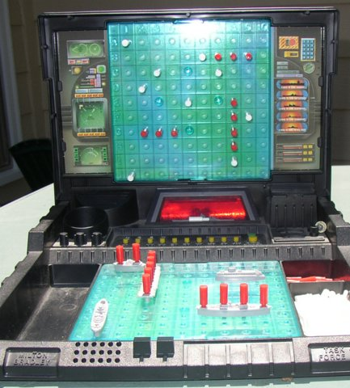

Example Two-Dimensional Arrays
Maps
  That street is in D-5
Battleship
  Try I-5
    Hit or miss
Chairs at a theater or game
  Row C seat 20

Slide 5
Nested Loop
How would you get all the pixels in a picture using their x and y values
  From left to right and top to bottom?
  x=0 and y=0, x=1 and y=0, x=2 and y=0, …
  x=0 and y=1, x=1 and y=1, x=2 and y=1, …
  x=0 and y=2, x=1 and y=2, x=2 and y=2, …
We need to have one loop inside another
  The outer loop counts y from 0 to height - 1
  The inner loop counts x from 0 to width - 1

Slide 6
Alternative Nested Loop
How would you get all the pixels in a picture using their x and y values
  From top to bottom and left to right?
  x=0 and y=0, x=0 and y=1, x=0 and y=2, …
  x=1 and y=0, x=1 and y=1, x=1 and y=2, …
  x=2 and y=0, x=2 and y=1, x=2 and y=2, …
We need to have one loop inside another
  The outer loop counts x to width - 1
  The inner loop counts y from 0 to height - 1

Slide 7
Nested Loop Template
// loop through the rows
for (int y = 0; y < this.getHeight(); y++)
{
// loop through the columns
for (int x = 0; x < this.getWidth(); x++)
{
// get the current pixel
pixelObj = this.getPixel(x,y);
// do something to the color
// set the new color
pixelObj.setColor(colorObj);
}
}

Slide 8
Alternative Nested Loop Template
// loop through the columns (x direction)
for (int x = 0; x < this.getWidth(); x++)
{
// loop through the rows (y direction)
for (int y = 0; y < this.getHeight(); y++)
{
// get the current pixel
pixelObj = this.getPixel(x,y);
// do something to the color
// set the new color
pixelObj.setColor(colorObj);
}
}

Slide 9
Lighten the Color Algorithm
Start x at 0 and loop while x < the picture width (add 1 to x at the end of each loop)
  Start y at 0 and loop while y < the picture height (add 1 to y at the end of each loop)
    Get the pixel at this location
    Get the color at the pixel
    Lighten (brighten) the color
    Set the color for the pixel to the lighter color

Slide 10
Lighten the Color with a Nested Loop
public void lighten()
{
Pixel pixelObj = null;
Color colorObj = null;
// loop through the columns (x direction)
for (int x = 0; x < this.getWidth(); x++)
{
// loop through the rows (y direction)
for (int y = 0; y < this.getHeight(); y++)
{

Slide 11
Lighten - Continued
// get pixel at the x and y location
pixelObj = this.getPixel(x,y);
// get the current color
colorObj = pixelObj.getColor();
// get a lighter color
colorObj = colorObj.brighter();
// set the pixel color to the lighter color
pixelObj.setColor(colorObj);
}
}
}

Slide 12
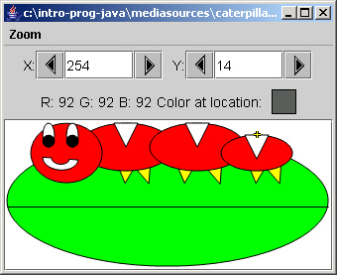
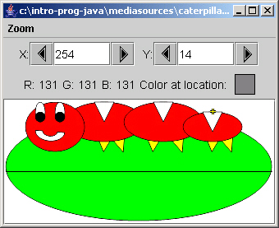
Trying the Lighten Method
In the interactions pane:
  String file =
  “c:/intro-prog-java/mediasources/caterpillar.jpg”;
  Picture p1 = new Picture(file);
  p1.explore();
  p1.lighten();
  p1.explore();

Slide 13

Changing to Nested Loop Exercise
Change the method clearBlue() to use a nested for loop to loop through all the pixels
Run the method again to check that it still works
Check that the blue values are all 0 using pictureObj.explore()

Slide 14
Summary
A two-dimensional array has columns and rows
Use nested loops to work with 2-d arrays
  One loop for the x direction and one for the y
for (int x = 0; x < this.getWidth(); x++)
{
// loop through the rows (y direction)
for (int y = 0; y < this.getHeight(); y++)
{

